Slide 1

HOME APPLIANCE MARKET TREND ANALYSIS
PRACHI PANDEY

Slide 2

STEPS INVOLVED
1.DATA FROM BEST BUYS UNITED STATES WEBSITE
2. DATA EXTRACTION FROM SITE
3. STORED SCRAPPED DATA IN A CSV FILE.
4. DATA CLEANING AND PREPROCESSING
5. EXPLORATORY DATA ANALYSIS (EDA)
6. REPORT AND INSIGHTS

Slide 3
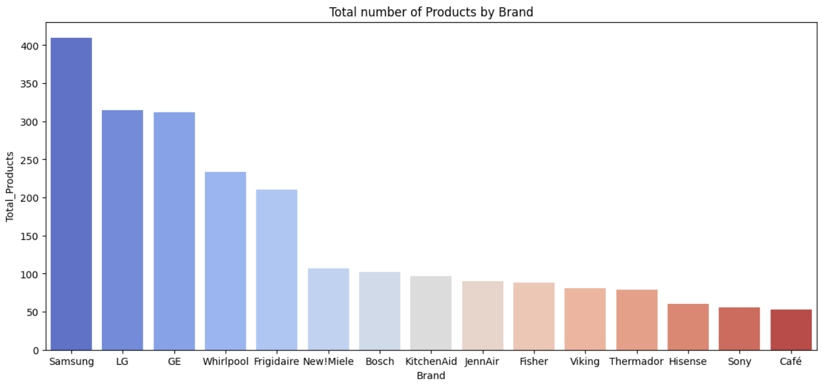
REPORT
We have Samsung and LG products more in the stock as its sale is quite large then the other brands in the region.

Slide 4
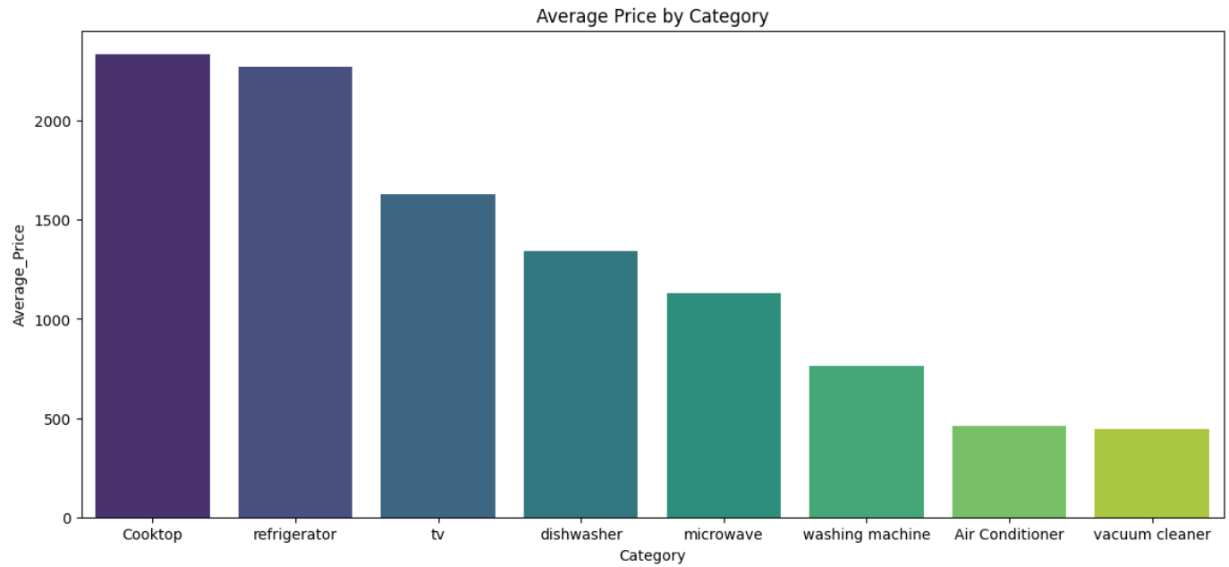
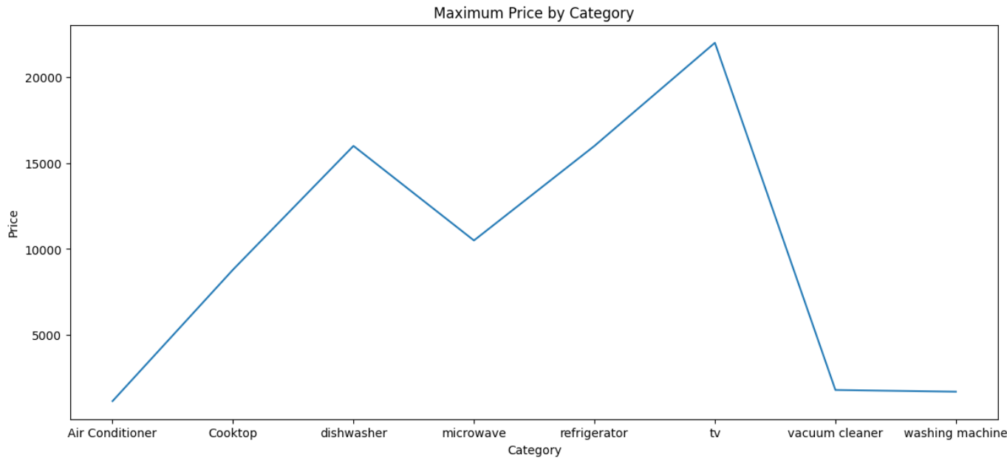
PRICE OF DIFFERENT PRODUCTS
Cooktop has the maximum Average Price and TV which has maximum price so we could say that the product which has maximum price in our data is the Television.

Slide 5
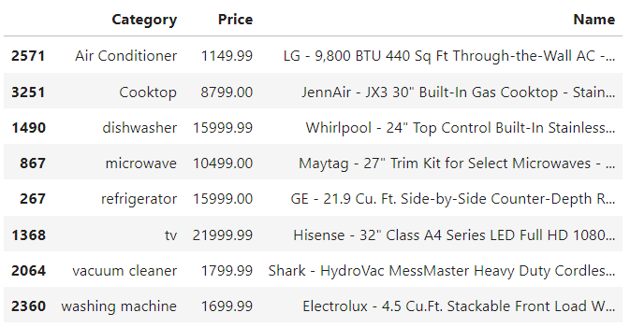

Products that are costliest in each Category.

Slide 6
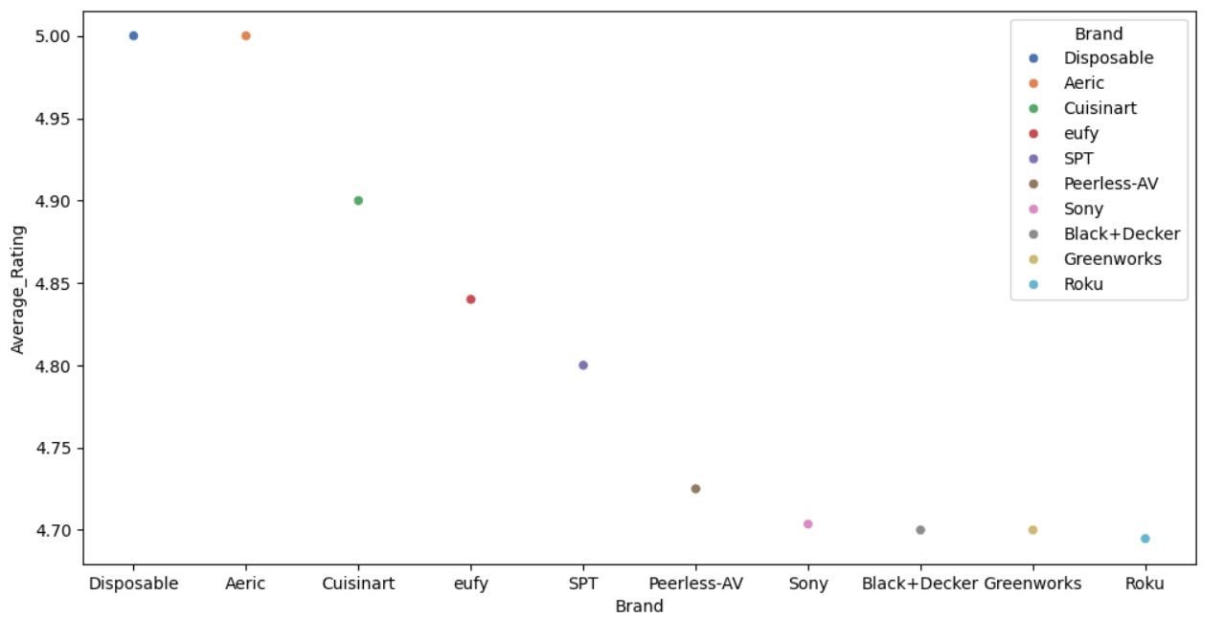
RATINGS
Disposable and Aeric are rated highest with the rating of 5, followed by Cuisinart with rating of 4.9 ,we can increase the number of top rated products as it is most liked by customers..

Slide 7
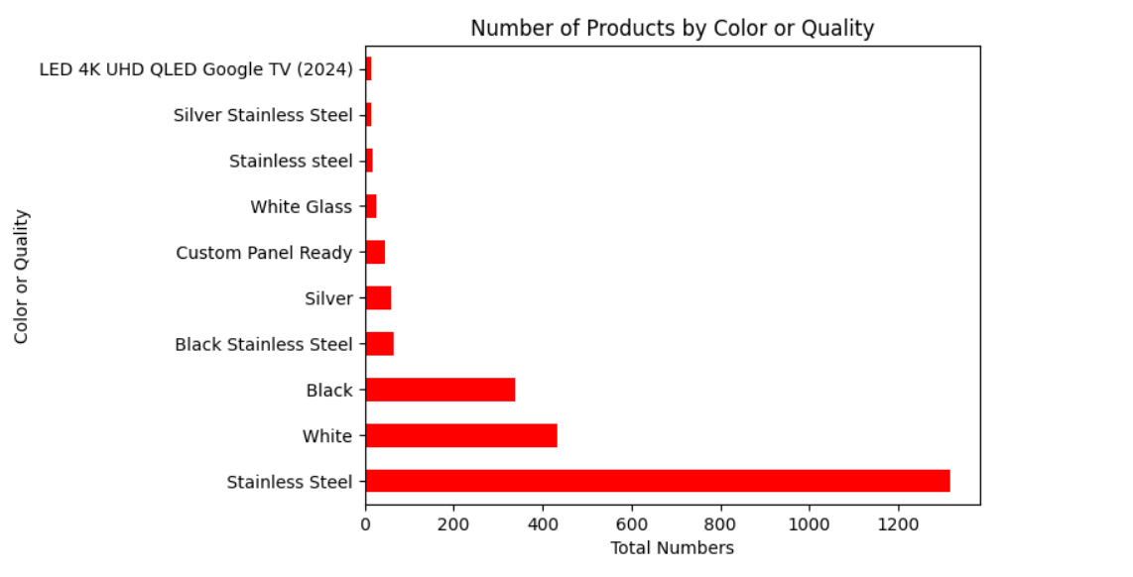
Stainless Steel Items are sold in huge numbers so we should consider increasing their numbers.

Slide 8
THANK YOU

